Slide 1
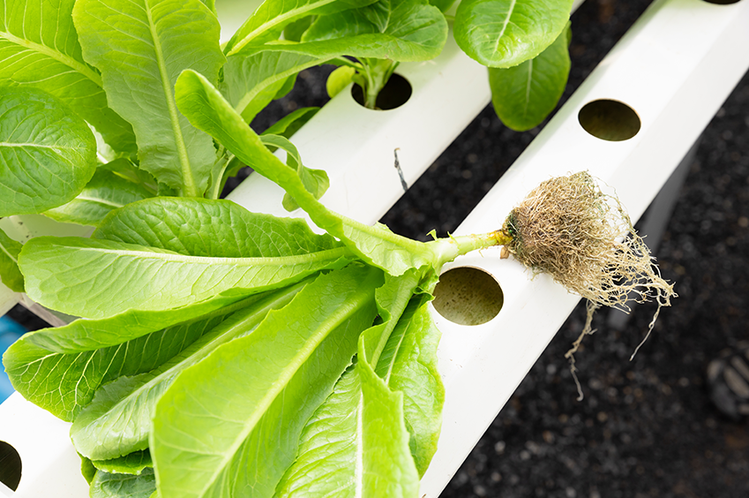
Growing Plants
Without Soil

Slide 2
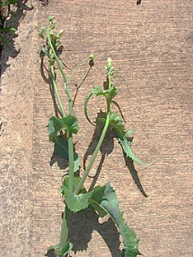
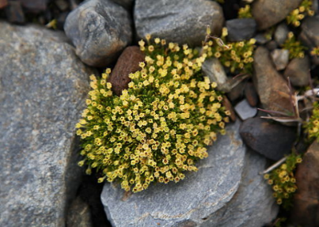
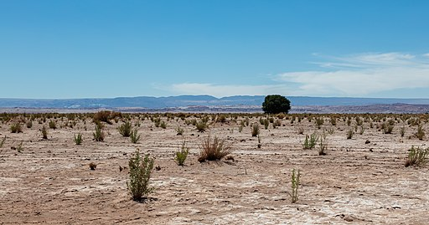
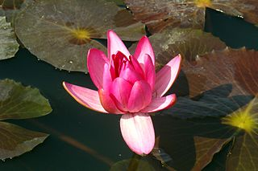
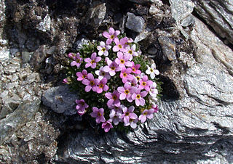
Animal? Vegetable? Mineral?
Plants are everywhere, even in the most unexpected places
In a crack in the pavement
In frozen Antarctica
In the most arid deserts
In lakes
On mountaintops
What do you think - are plants living organisms?
(Yes? No? Partially?)
Forest & Kim Starr, CC BY 3.0 US, via Wikimedia Commons
Starr-070215-4504-Sonchus_oleraceus-plant_on_pavement
-Old_macadamia_nut_orchards_Waiehu-Maui_(24255550983).jpg
Liam Quinn, CC BY-SA 2.0 via Wikimedia Commons Antarctic_Pearlwort.jpg
Diego Delso, CC BY-SA 4.0, via Wikimedia Commons: Paisaje_en_el_desierto_de_Atacama,_Chile,_2016-02-06,_DD_16.JPG
https://en.wikipedia.org/wiki/File:Water_Lily_Sambalpur.jpg
MurielBendel, CC BY-SA 4.0, via Wikimedia Commons Androsace_alpina_Riffelberg.jpg

Slide 3
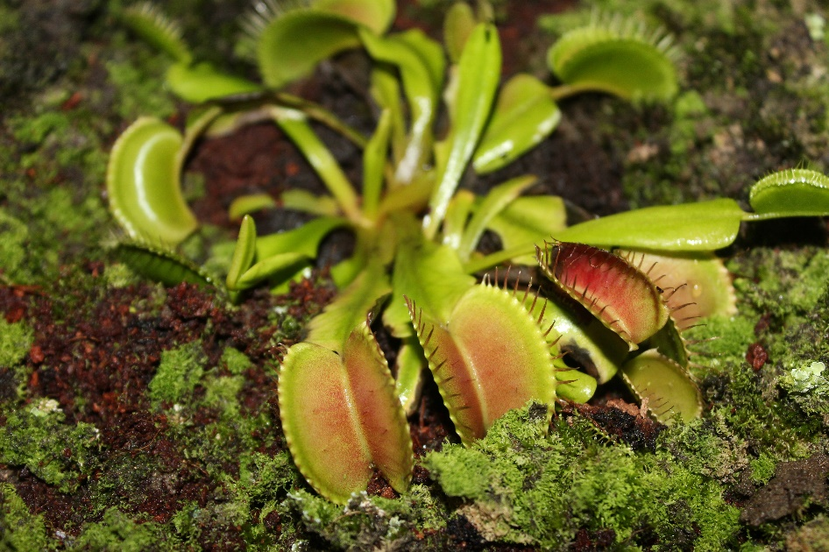
Plants As Living Organisms
Plants are living organisms. They possess all of the characteristics of life:
Growth and development
Reproduction
Feeding
Respiration
Communication with the environment
Movement
Photo by Rineshkumar Ghirao on Unsplash

Slide 4
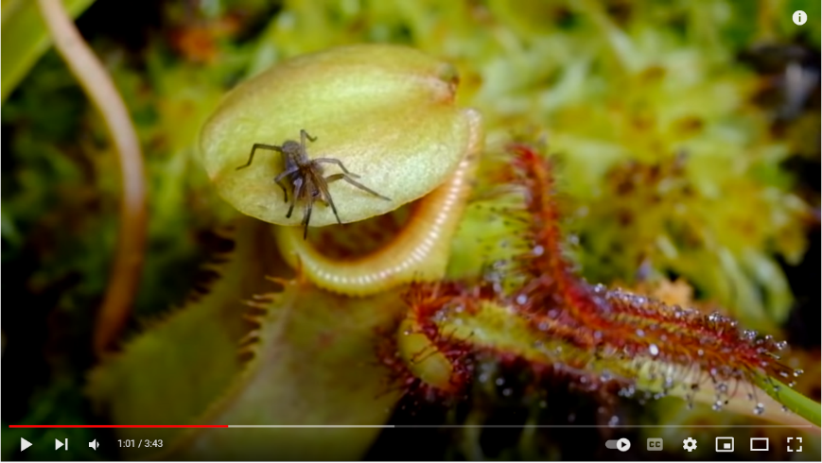
Plants As Living Organisms
Watch the video and write down what characteristics of life you can identify in the plants:
https://www.youtube.com/watch/UoL1dg3SzOI

Slide 5
Plants As Living Organisms
Have you identified all these characteristics of life in this video?
Growth and development
Reproduction
Feeding
Respiration
Communication with the environment
Movement

Slide 6
What Do Plants Need?
As with any other living creature, plants too have basic needs. These are materials and conditions they require in order to exist, to grow and to reproduce.
What are the plant’s main basic needs?
Photo by Jamie Street on Unsplash

Slide 7
What Do Plants Need?
As with any other living creature, plants too have basic needs. These are materials and conditions that they require in order to exist, to grow and to reproduce.
What are the plant’s main basic needs?
Light
Water
Air
Nutrients
Anchorage
Protection against pests
Proper temperature
Photo by Jamie Street on Unsplash

Slide 8
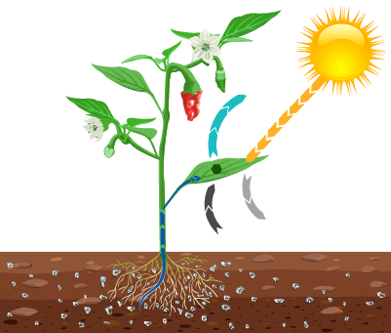
What Do Plants Need?
Light, water and air are necessary for plants in order to photosynthesize - a process in which the plant produces its own sugar as a source of food and energy.
In photosynthesis, the plant’s green parts take in light, water and carbon dioxide CO₂ - which is present in the air, and then it releases oxygen and water vapor.
water
vapor
light
water
CO₂
oxygen

Slide 9
What Do Plants Need?
Like most living organisms, plants require oxygen for their existence.
The green parts of the plant absorb oxygen from the air.
The plant’s roots absorb oxygen from pockets of air in the soil.
The plant’s roots absorb water and various nutrients (minerals) from the soil.

Slide 10
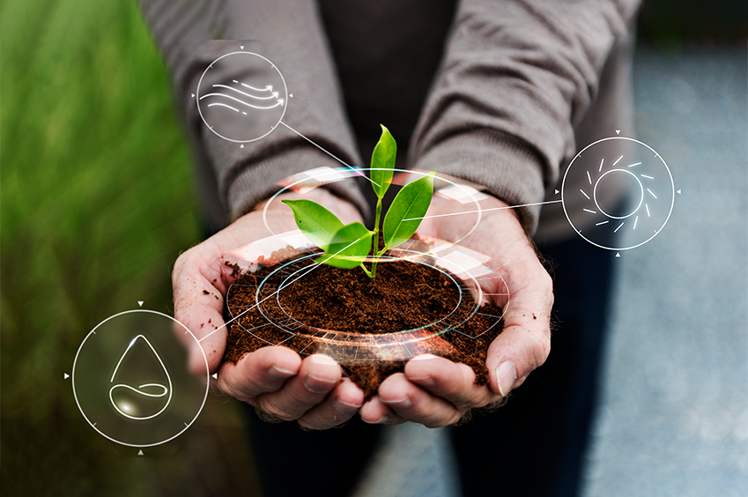
Are the Quantities Important?
Does it matter how much of each basic need a plant receives?
Do you think the more a plant receives of each basic need, the better it will grow?
Photo by Михаил Павленко on Unsplash

Slide 11
Are the Quantities Important?
For a plant to reach optimal growth, it needs a suitable range of each one of its basic needs. Too much or too little will be harmful to its growth.
For example, if we do not provide a plant with enough water - it will wilt.
If we give it too much water - its roots will not receive oxygen, causing them to rot and the plant will eventually die.
Photo by Михаил Павленко on Unsplash

Slide 12
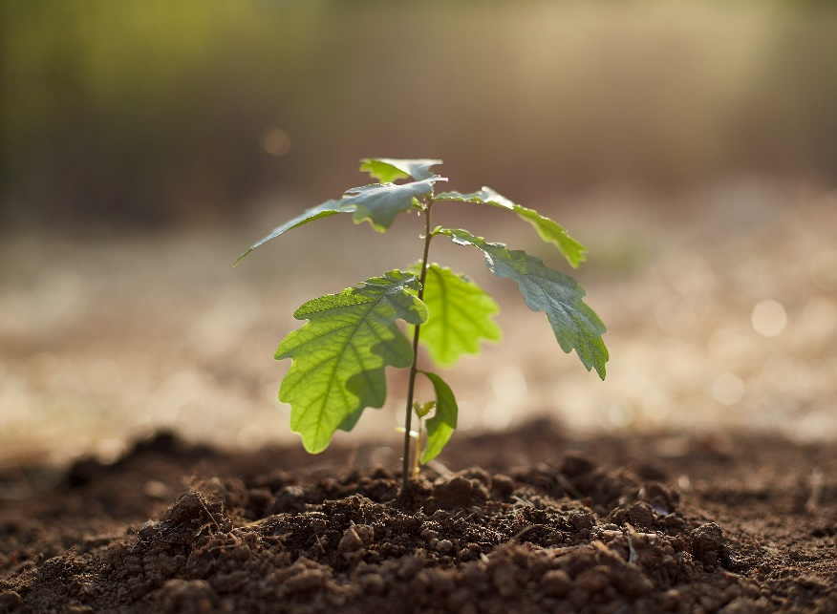
Why is Soil Needed?
Most plants grow in soil.
Does soil play a role in obtaining the plant’s basic needs?
If so - which basic needs does the soil fulfill?
Light
Water
Air
Nutrients
Anchorage
Protection against pests
Proper temperature
Photo by Михаил Павленко on Unsplash

Slide 13
Why is Soil Needed?
Soil plays a role in the provision of most of the plant’s needs.
What role does soil play in fulfilling this need? | The Basic Need
Roots absorb water from the soil | Water
The roots absorb oxygen from pockets of air in the soil | Air
The roots absorb nutrients (natural or fertilizer) which are dissolved in the water within the soil. | Nutrients
The roots burrow into the ground and anchor the plant | Anchorage
The soil insulates the roots, protecting them against overheating or overcooling | Proper temperature
At the same time, soil is a source of numerous diseases, which are harmful to the plant.

Slide 14
Hydroponics - Growing Without Soil
Hydroponics is one of the popular methods of cultivation in urban agriculture.
With this method, the plants grow on a medium consisting of a solution of water and fertilizer, with no soil involved.
Hydroponics: hydro = water, ponic = work.
https://www.freepik.com/free-photo/hydroponics-system-planting-vegetables-herbs-without-using-soil-health_4284035.htm#query=hydroponics&position=5&from_view=search&track=sph Image by jcomp on Freepik

Slide 15
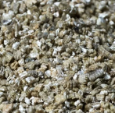
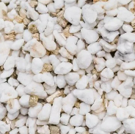
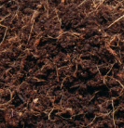
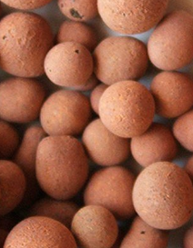
Hydroponics - Growing Without Soil
In hydroponics, plants grow without soil. However, sometimes the planting vessel includes a growth medium, which is
a material with no nutritional value
that usually contains aerated pores
and is capable of absorbing certain amounts of water.
Examples of growth media:
Vermiculite
Perlite
Coconut shreds or coconut fiber
Clay pebbles (Hydroton)

Slide 16
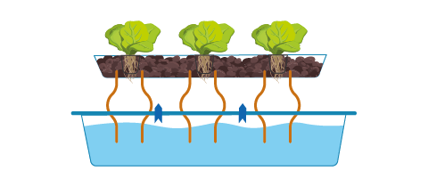
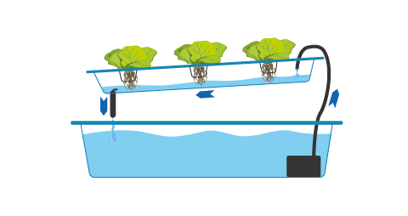
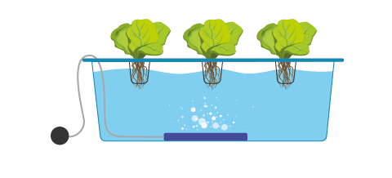
Hydroponics - A Technological Solution for Plant Needs
A hydroponic system provides a technological solution for the plant’s various needs.
The better the hydroponic system is able to fulfill more of the soil’s functions, providing more of the plant’s needs, the better and more efficiently it enables the plant to grow.
Common types of hydroponic systems are:
Wick NFT DWC
https://www.freepik.com/free-photo/hydroponics-system-planting-vegetables-herbs-without-using-soil-health_4284035.htm#query=hydroponics&position=5&from_view=search&track=sph Image by jcomp on Freepik

Slide 17
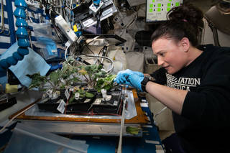
Hydroponic Systems in Space
Can edible plants be grown in space?
Yes! The crew on board the International Space Station is growing lettuce, kale, and even chili peppers. One of the methods enabling soilless cultivation of vegetables in space is hydroponics.
The crew of the future Mars mission will need this knowledge as they will be far from Earth.
Notes:
Credit: ESA/Alexander Gerst

Slide 18
Group Activity: Researching and Recommending a Hydroponic System
Research one of the types of hydroponic systems.
Prepare a 2-minute elevator pitch:
How does the system provide the plant with its key needs?
Why do you think this system is recommended for use on the far away planet Mars?
What is an elevator pitch?
https://www.youtube.com/watch?v=Tq0tan49rmc
https://www.freepik.com/free-photo/hydroponics-system-planting-vegetables-herbs-without-using-soil-health_4284035.htm#query=hydroponics&position=5&from_view=search&track=sph Image by jcomp on Freepik

Slide 19
Group Activity: Researching and Recommending a Hydroponic System
Research one of the types of hydroponic systems.
Prepare a 2-minute elevator pitch:
How does the system provide the plant with its key needs?
Why do you think this system is recommended for use on the far away planet Mars?
Group 1 - Wick
Group 2 - NFT
Group 3 - DWC
https://www.freepik.com/free-photo/hydroponics-system-planting-vegetables-herbs-without-using-soil-health_4284035.htm#query=hydroponics&position=5&from_view=search&track=sph Image by jcomp on Freepik

Slide 20
Similarities Between the Hydroponic Systems
What do all the hydroponic systems we have seen have in common?
They provide the plants with their basic needs.
Use of a nutrient solution composed of water and fertilizer.
The conditions within the nutrient solution can be measured and controlled.
A main reservoir of the nutrient solution.
Planting vessels (basket or perforated container).

Slide 21
Differences Between the Hydroponic Systems
There are differences between the hydroponic systems. For example:
Method of delivering oxygen to the roots:
Use of an air pump and an air stone
Water flow
Keeping part of the roots outside the water
With or without nutrient solution flow

Slide 22
Hydroponic Systems - Similarities and Differences
Additional differences:
the kind of plants that can be grown, the number of plants, the possible locations for the system, the systems’ stability, their cost and ease of operation.
It is impossible to clearly state which system is better!
One has to examine which system is better suited to the needs and limitations of the grower and of the location.

Slide 23
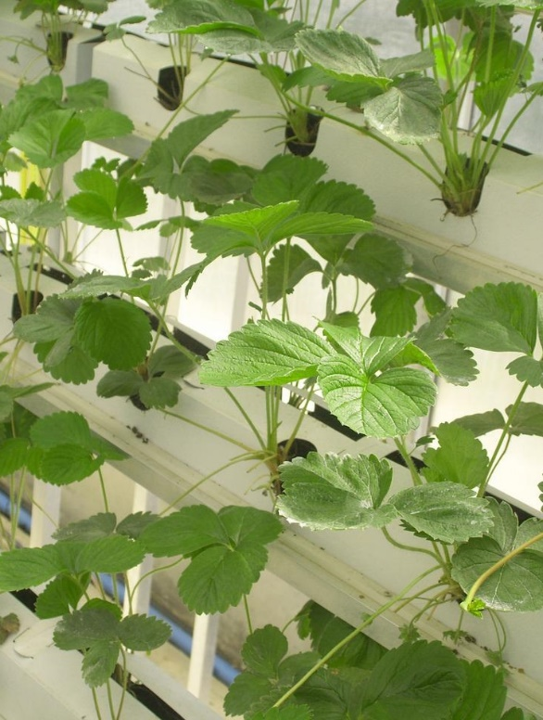
Advantages of Hydroponic Cultivation
Enables growing plants even in a soilless environment or where the soil is of low quality
Full control of nutrients’ delivery
Possibility for rapid plant growth
Saving water
Virtually free of weeds, insects and diseases
Reduced use of pesticides
Cleaner agricultural produce

Slide 24
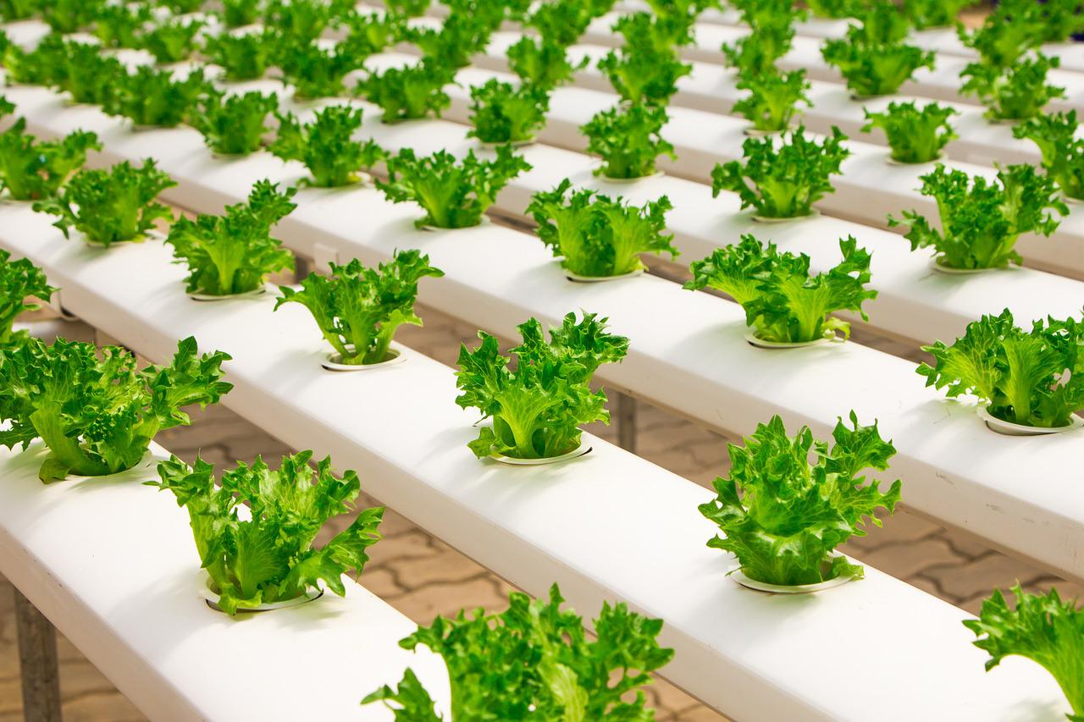
Challenges and Limitations of Hydroponic Cultivation
High cost of initial set-up
Requires knowledge for system maintenance
Unstable - dependent on an uninterrupted supply of electricity
Relatively highconsumption of electricity compared with conventional crop farming
Not suitable for all types of plants

Slide 25
Summary
We have learned that plants can be grown almost anywhere, even without the use of soil at all.
We have learned about various kinds of hydroponic systems.
What they all have in common is the ability to provide all of the plants’ needs, under finely-tuned conditions, facilitating efficient growth, saving on water, fertilizers and pesticides and protecting the environment.

