Slide 1
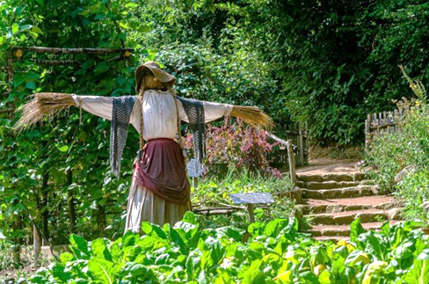
Urban Agriculture -
How and Why?

Slide 2
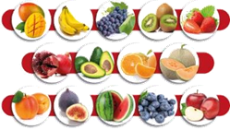
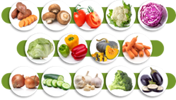
What Do We Like To Eat?
The food we eat has an effect on our health.
In order to maintain a healthy, balanced diet, it is important to eat a variety of fruits and vegetables every day.
Marco Verch Professional Photographer
Gila Brand, CC BY 2.5 <https://creativecommons.org/licenses/by/2.5>, via Wikimedia Commons FranHogan, CC BY-SA 4.0 <https://creativecommons.org/licenses/by-sa/4.0>, via Wikimedia Commons

Slide 3
What Do We Like To Eat?
What is your favorite fruit or vegetable?
Marco Verch Professional Photographer
Gila Brand, CC BY 2.5 <https://creativecommons.org/licenses/by/2.5>, via Wikimedia Commons FranHogan, CC BY-SA 4.0 <https://creativecommons.org/licenses/by-sa/4.0>, via Wikimedia Commons

Slide 4
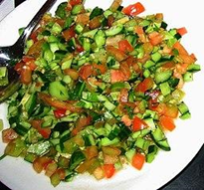
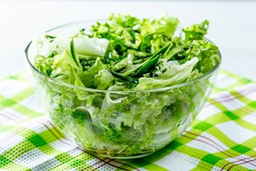
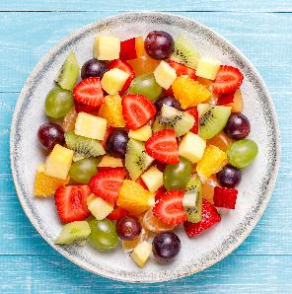
Where Does Salad Come From?
Who knows where these fruits and vegetables come from?
Marco Verch Professional Photographer
Gila Brand, CC BY 2.5 <https://creativecommons.org/licenses/by/2.5>, via Wikimedia Commons FranHogan, CC BY-SA 4.0 <https://creativecommons.org/licenses/by-sa/4.0>, via Wikimedia Commons

Slide 5
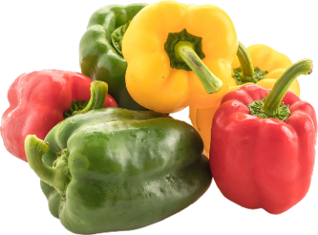
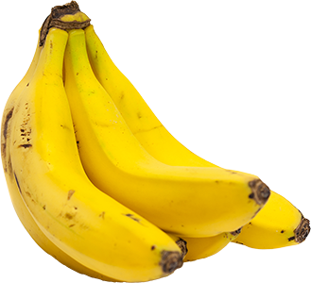
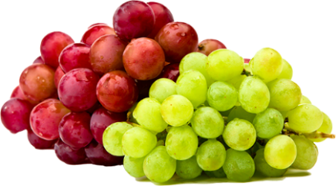
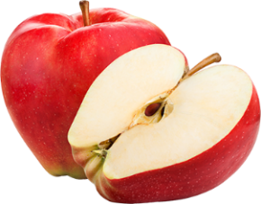
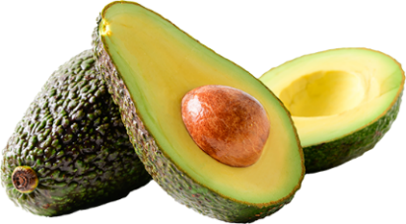

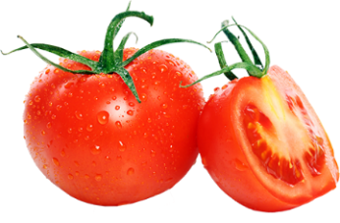
Where Does Salad Come From?
Some of the fruits and vegetables are grown in Israel. For example:
tomatoes, potatoes, peppers, bananas, apples, olives and grapes.

Slide 6
Where does Salad Come From?
What About the Rest of the Fruit and Vegetables?
Some of them are imported from abroad - for example:
Some of the cucumbers we consume are imported from Turkey.
Pears are imported from Europe and the United States.
Apples are imported mostly from the United States.
Corn is imported mostly from Malaysia.
Garlic is imported mostly from China.
Most of the oranges sold in Israel are imported.

Slide 7
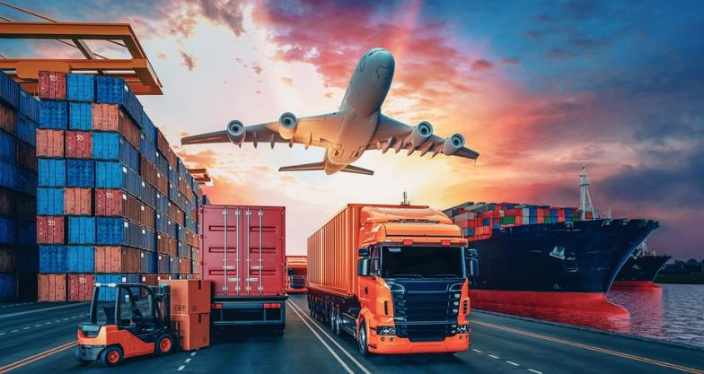
From the Farmer to Us
In order to bring the food from the fields (in Israel or abroad) to the population centers, it needs to be packed and transported.
Did you know -
the cost of packing and transport in Israel alone total approximately one billion Shekels per year!

Slide 8
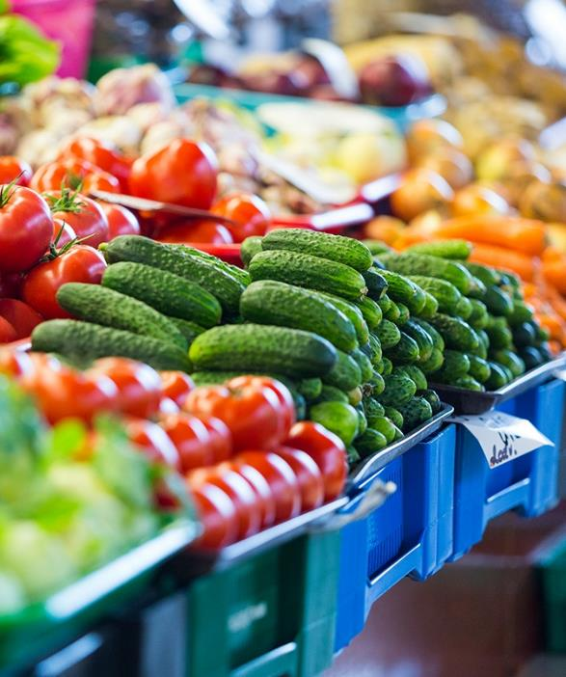
From the Farmer to Us
Take a guess:
On average, how much time passes from the moment the fruits and vegetables are harvested in Israel until they arrive in the market or on the grocery shelves?
a. Half a day
b. A day or two
c. 3-4 days
d. About a week
Notes:
From start to 3:37

Slide 9
From the Farmer to Us
The correct answer is 3-4 days.
This is the average time from the moment the fruits and vegetables are harvested in Israel until they arrive in the market or on the grocery shelves.

Slide 10
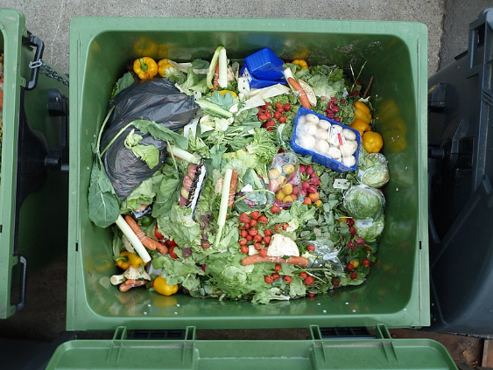
From the Farmer to Us
Due to the long journey they undergo and due to storage problems, some of the agricultural produce spoils.
Take a guess:
What percentage of fruits and vegetables get thrown away before they reach the consumer?
a. About 1 percent
b. Between 10 and 20 percent
c. Between 35 and 55 percent
d. Almost 90 percent
Notes:
From start to 3:37

Slide 11

From the Farmer to Us
The correct answer is:
Between 35 and 55 percent of all fruits and vegetables spoil and are thrown away before reaching the consumer.
Another percentage is thrown away in the consumers’ homes.
Notes:
From start to 3:37

Slide 12
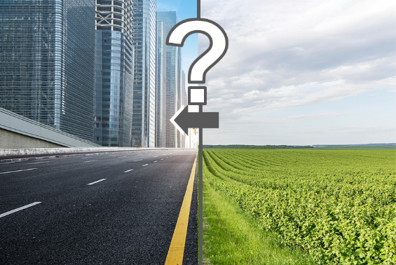
What Are the Implications of Agricultural Cultivation Far Removed From the Consumers?
We have seen that most of the fruits and
vegetables we eat have a long journey
before they reach us, the consumers.
The implications are:
We almost never get to eat fresh produce due
to the fact that there are so many steps
between the growing and the marketing.
Fuel used in the process causes air pollution.
Use of packing materials pollutes the environment.
When food spoils in transit or in storage, it causes a waste of the resources invested in it (water, fertilizer, pesticides, fuel). This also increases environmental damage.
Food prices increase since the consumers pay the costs of the shipping, packing, storage and wasted resources.
Notes:
From start to 3:37

Slide 13
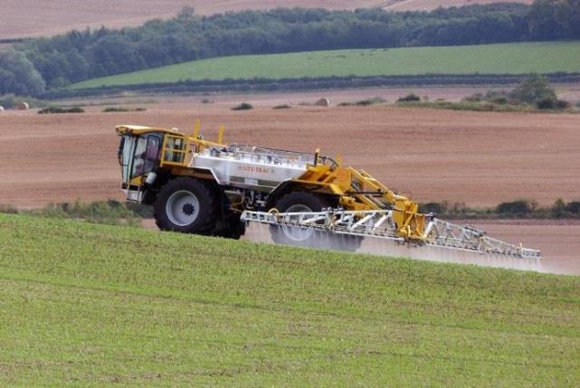
Industrial Agriculture - What Does This Mean?
The agricultural produce we buy has been grown using mostly industrial agriculture practices, meaning:
    Growing very large quantities of plants
    Using farming machinery: tractors, harvesters, spray planes, etc.
    Using advanced pesticides
    Using effective fertilizers
Lite-Trac, CC BY-SA 3.0 <https://creativecommons.org/licenses/by-sa/3.0>, via Wikimedia Commons
Notes:
Industrial agriculture is a modern form of agriculture which refers to the industrial production of livestock, dairy products, and food crops such as cereals, fruit and vegetables and vegetables.
Industrial agriculture began developing at the beginning of the industrial revolution with the invention of the mechanized cotton pickers, combine harvesters, tractors and other agricultural machinery.
The methods used in industrial agriculture include the use of agricultural machinery (tractors, harvesters, spray planes, etc.), use of chemical fertilizers, and widespread use of fossil fuel-based pesticides.

Slide 14

Industrial Agriculture - What Are the Problems?
Industrial agriculture is highly efficient and is vital to the supply of food for the entire population.
However, it is also the cause of several environmental problems:
Water losses in the irrigation process
Groundwater pollution with fertilizers and
pesticides
Soil salinization
Depletion of soil nutrients
Lite-Trac, CC BY-SA 3.0 <https://creativecommons.org/licenses/by-sa/3.0>, via Wikimedia Commons
Notes:
Industrial agriculture is a modern form of agriculture that refers to the industrial production of food crops such as cereals, fruit and vegetables and vegetables.
Industrial agriculture began developing at the beginning of the industrial revolution with the invention of the mechanized cotton pickers, combine harvesters, tractors and other agricultural machinery.
The methods used in industrial agriculture include the use of agricultural machinery (tractors, harvesters, spray planes, etc.), the use of chemical fertilizers, and the widespread use of fossil fuel-based pesticides.

Slide 15
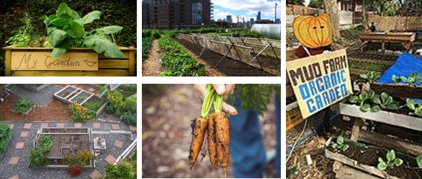
Urban Agriculture
Urban agriculture is the cultivation of agricultural produce in small patches of land in an urban setting.
'image: Flaticon.com'. This cover has been designed using resources from Flaticon.com Image byMarkus Spiske from https://pixabay.com/
image by congerdesign from https://pixabay.com/ Linda from Chicago, USA, CC BY 2.0 https://creativecommons.org/licenses/by/2.0>, via Wikimedia Commons
Image by MikeMcLaren from https://pixabay.com/Mactan Urban Demonstration Farm, CC BY-SA 4.0 <https://creativecommons.org/licenses/by-sa/4.0>, via Wikimedia Commons

Slide 16
Group Activity - Studying Urban Agriculture
So where exactly can we practice urban agriculture? How is this done? And what advantages are there?
Let’s split into three groups.
Each group:
will study a different aspect of urban agriculture by searching in various information resources
will summarize the information in 2-3 slides
will prepare a presentation to be delivered during the lesson, for a duration of 2 minutes

Slide 17
Group Activity - Studying Urban Agriculture
.
The aspects we shall study are:
What areas within towns can be used for urban agriculture?
What are the main cultivation methods in urban agriculture?
What are the advantages of urban agriculture?
Additional search keywords you can use are: urban agriculture, community agriculture.

Slide 18
Group Activity - Studying Urban Agriculture
Each group will present the results of its study.

Slide 19
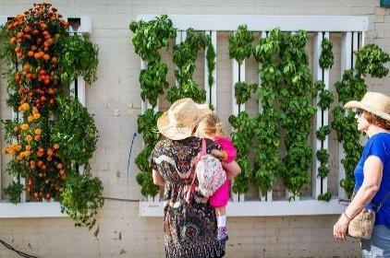
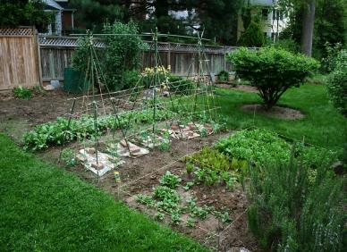
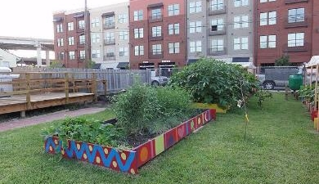
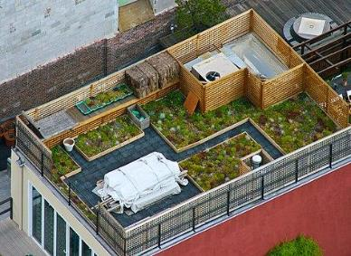
Urban Agriculture - Locations
Green Walls - vertical garden
Backyard gardens
Community gardens in public spaces
Roof gardens
Bart Everson from New Orleans, Louisiana, USA, CC BY 2.0 via Wikimedia Commons, woodleywonderworks flickr Jwilly77, CC BY-SA 3.0 <https://creativecommons.org/licenses/by-sa/3.0>, via Wikimedia Commons Bright Agrotech, CC BY-SA 4.0 <https://creativecommons.org/licenses/by-sa/4.0>, via Wikimedia Commons

Slide 20
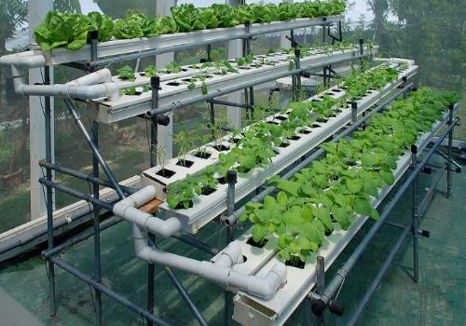
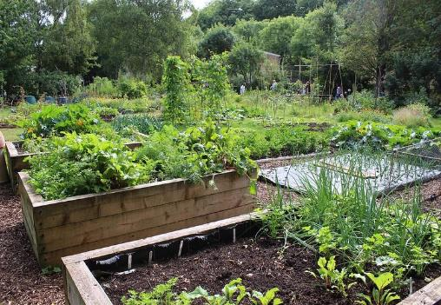
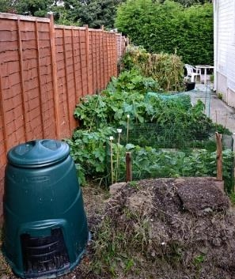
Urban Agriculture - Methods
Hydroponic (soilless, water-based)
Detached substrate
Furrows
DILOSEP11_D5-3171 Local Food Initiative
Choo Yut Shing

Slide 21
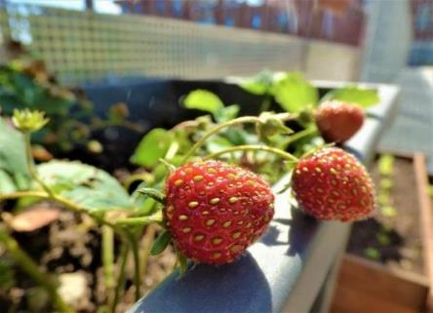
Urban Agriculture - Advantages
Fresh produce - picked directly before use
Reduced food waste - pick what you need, when you need it
Less transport, packing and storage - reduced cost, reduced environmental impact
Reduced use of pesticides
Possibility to grow plants in non-arable areas
Community gardens also contribute toward the welfare of the community and the society.

Slide 22

Where would you set up a small garden in your surroundings?
Suggest suitable places for urban agriculture in your town, school or home.
?

