Slide 1
Bringing Urban Agriculture to the Community

Slide 2
Group Game - What Do We All Have In Common?
Break up into groups of 4-6 students.
Write down as many things as possible that are common to all the members in the group.

Slide 3
What is a Community?
“A group of individuals, who share certain common factors. For example: where they live, common interests, shared goals, customs, beliefs, values, religion, social bonds”.
An individual usually belongs to multiple different communities.

Slide 4
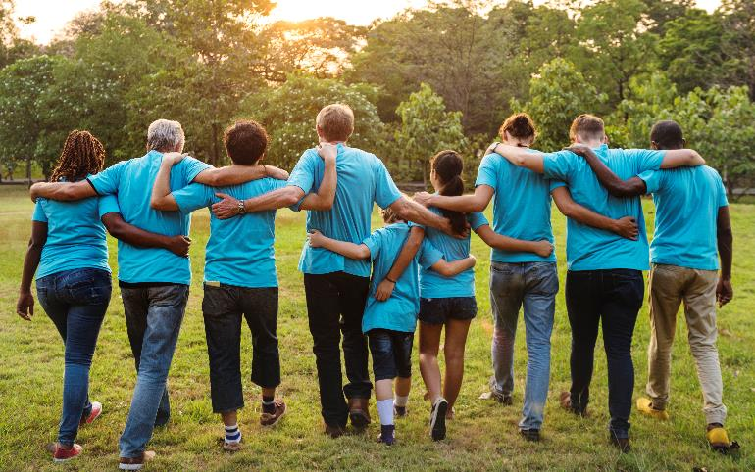
What do we Gain from the Community?
Belonging - a basic need of every person to belong to a group of people.
Identity - identification with the norms, values and beliefs of a community.
Fulfillment of personal needs - such as socializing, recreational activities, areas of interest, medical services, food.
Meaning - the desire and ability to contribute toward the community.

Slide 5
The Class Challenge: Planning and executing an initiative related to urban agriculture within our community.
Having learned a bit about urban agriculture, we will try to contribute to our community on this matter.
The stages:
Choosing an idea for an initiative
Planning
Execution within the community

Slide 6
Game: Outside-the-Circle Ideas
Each student will brainstorm as many ideas as possible for things that can be added to the circles to produce something new (for example: a magnifying glass) and draw them on the worksheet. Time allocated: 5 minutes.

Slide 7
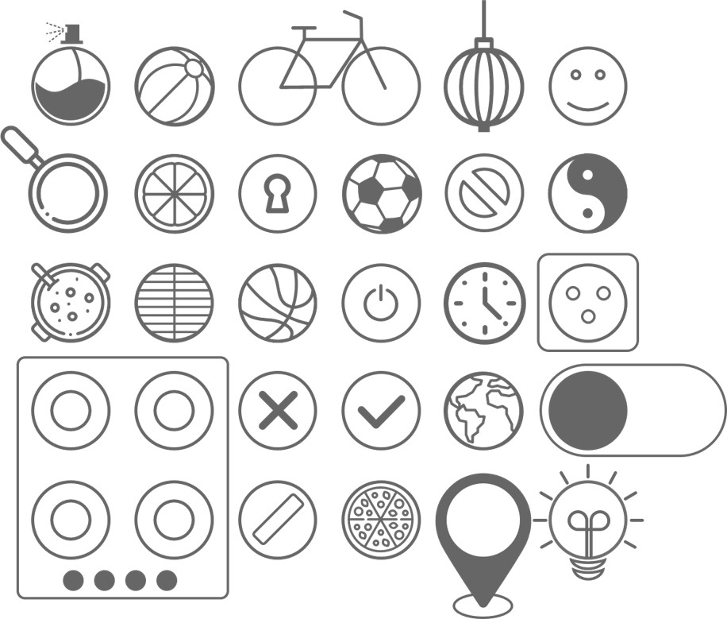
Outside-the-Circle Ideas - Examples

Slide 8
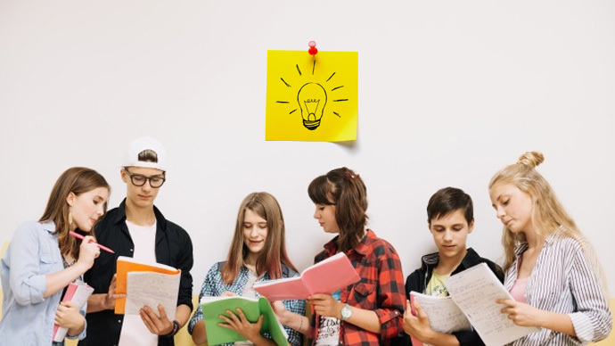
I’ve got an Idea
Suggest as many as possible ideas for community activities, which are related to urban agriculture or to the hydroponic garden.
While seeking the ideas, let’s try to keep 3 main questions in mind:
What kind of community will we be wanting to operate in?
What change will be brought about in the community due to our activity?
How will we carry it out?
Let’s write all the ideas on the whiteboard.

Slide 9
How is the Idea For Our Initiative Selected?
Among the ideas, let’s look for:
An innovative idea that makes a contribution toward the community
In idea we will be able to carry out within the time and under the conditions we have at our disposal

Slide 10
How is the Idea For Our Initiative Selected?
Easy
NOW
WOW
Ordinary
Innovative
LOW
HOW
Difficult

Slide 11
Bringing the Idea for the Class Initiative into Focus
Let’s define, in detail, our idea, in order for it to serve as a sound basis for our further planning and execution.
1. Brief description of the initiative
2. In what kind of community will we be operating in?
Keep it simple!
3. What is the purpose?
4. How will we accomplish our purpose?

Slide 12
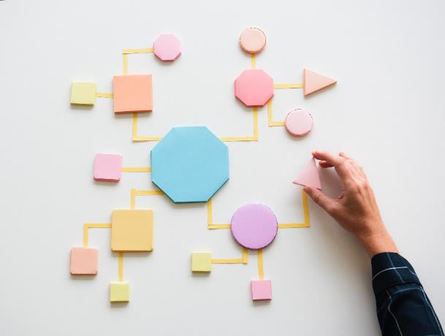
Planning the Initiative
The planning stage is a highly-important stage.
It includes, for example:
A definition of all the required tasks
Appointment of persons responsible for each task
Setting a timetable
Listing of the equipment, materials, and assistance
Budgetary estimate and fundraising
Etc.
A complete, detailed plan will form a good, solid basis for carrying out the activity.
By using a shared application, we will be able to track progress efficiently.
Notes:
https://www.freepik.com/free-vector/time-management-concept-flat-composition-poster_4341393.htm#page=3&query=%D7%A4planing+a+project&position=22
<a href='https://www.freepik.com/vectors/infographic'>Infographic vector created by macrovector - www.freepik.com</a>

Slide 13
Highlights for the Planning Stage:
Coordinate a date for the initiative with all stakeholders.
Plan a timetable suitable for completing all the tasks.
Advertise the initiative in advance, in order to enable as many as possible members of the community to take part in it.
Requesting assistance from other persons from within and from outside the school as needed.
A clear assignment of roles.
Documentation of all stages in writing and photographically.

Slide 14
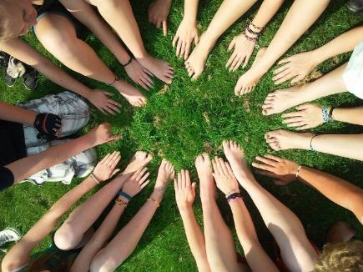
Carrying Out The Initiative
We have now reached the final, most important stage - carrying out the initiative.
It is important to track the planning schedule while at the same time to be prepared for unforeseen changes and to adjust the execution to these changes.
Good Luck!!

